Slide 1
Digital Logic Design

Slide 2
Comparators
Compare the magnitude of two binary numbers for the purpose of establishing whether one is greater than, equal to, or less than the other.
A comparator makes use of a cascade connection of identical subnetworks similar to the case of the parallel adder.

Slide 3
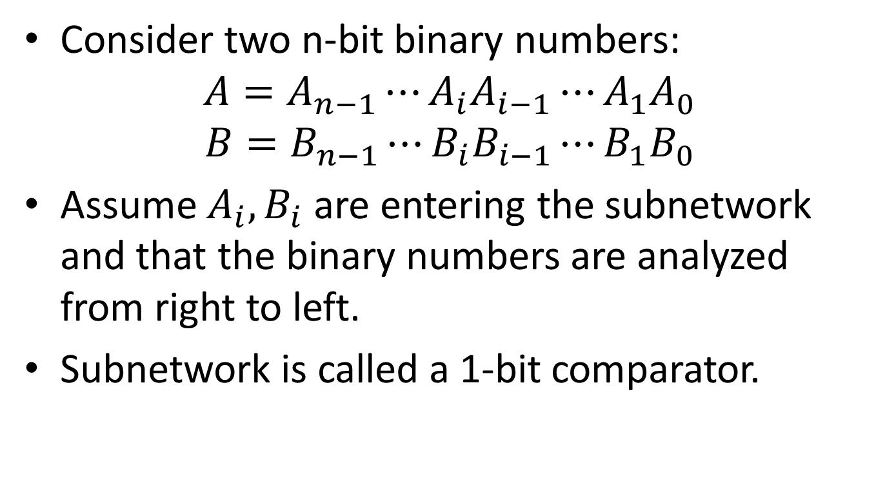
Comparators
Consider two n-bit binary numbers:
$$A=A_{n−1}⋯A_{i}A_{i−1}⋯A_{1}A_{0}$$
$$B=B_{n−1}⋯B_{i}B_{i−1}⋯B_{1}B_{0}$$
Assume $A_{i}, B_{i}$ are entering the subnetwork and that the binary numbers are analyzed from right to left.
Subnetwork is called a 1-bit comparator.

Slide 4
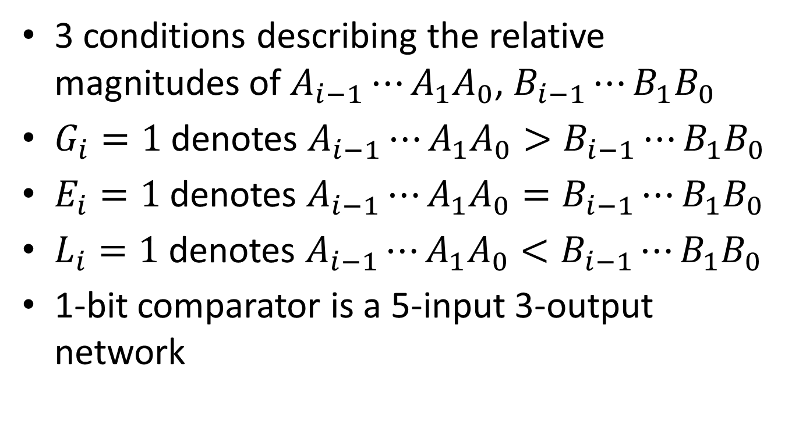
Comparators
3 conditions describing the relative magnitudes of $A_{i−1}⋯A_{1}A_{0}$, $B_{i−1}⋯B_{1}B_{0}$
$G_{i}=1$ denotes $A_{i−1}⋯A_{1}A_{0}>B_{i−1}⋯B_{1}B_{0}$
$E_{i}=1$ denotes $A_{i−1}⋯A_{1}A_{0}=B_{i−1}⋯B_{1}B_{0}$
$L_{i}=1$ denotes $A_{i−1}⋯A_{1}A_{0}<B_{i−1}⋯B_{1}B_{0}$
1-bit comparator is a 5-input 3-output network

Slide 5
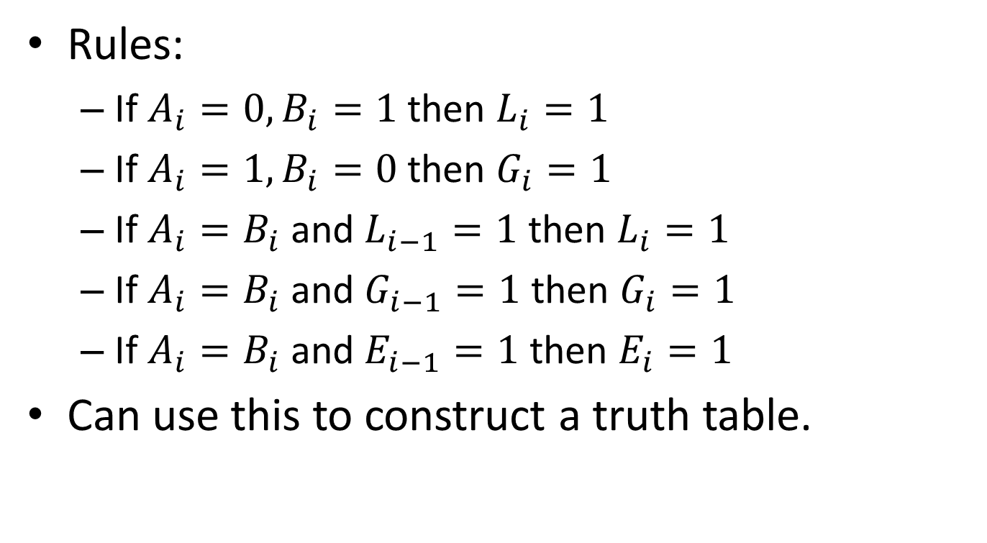
Comparators
Rules:
If $A_{i}=0, B_{i}=1$ then $L_{i}=1$
If $A_{i}=1, B_{i}=0$ then $G_{i}=1$
If $A_{i}=B_{i}$ and $L_{i−1}=1$ then $L_{i}=1$
If $A_{i}=B_{i}$ and $G_{i−1}=1$ then $G_{i}=1$
If $A_{i}=B_{i}$ and $E_{i−1}=1$ then $E_{i}=1$
Can use this to construct a truth table.

Slide 6
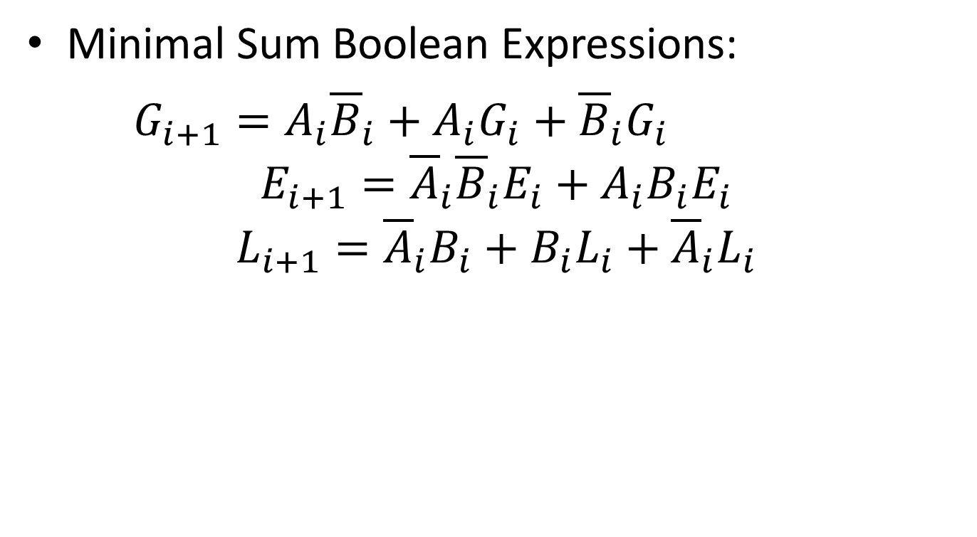
Comparators
Minimal Sum Boolean Expressions:
$$G_{i+1}=A_{i}{\overline{B}}_{i}+A_{i}G_{i}+{\overline{B}}_{i}G_{i}$$
$$E_{i+1}={\overline{A}}_{i}{\overline{B}}_{i}E_{i}+A_{i}B_{i}E_{i}$$
$$L_{i+1}={\overline{A}}_{i}B_{i}+B_{i}L_{i}+{\overline{A}}_{i}L_{i}$$

Slide 7
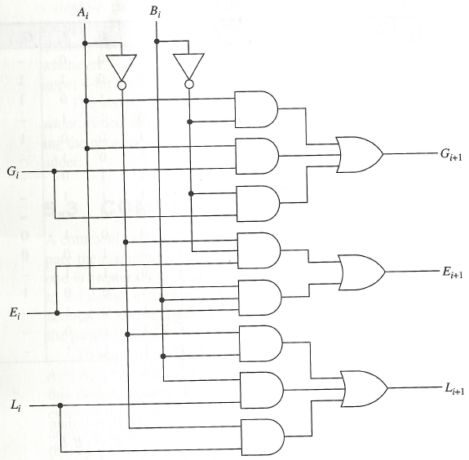
Comparators

Slide 8
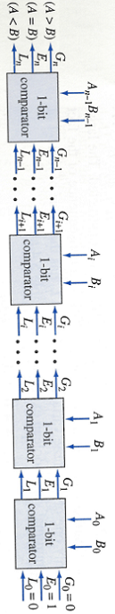
Comparators

Slide 9
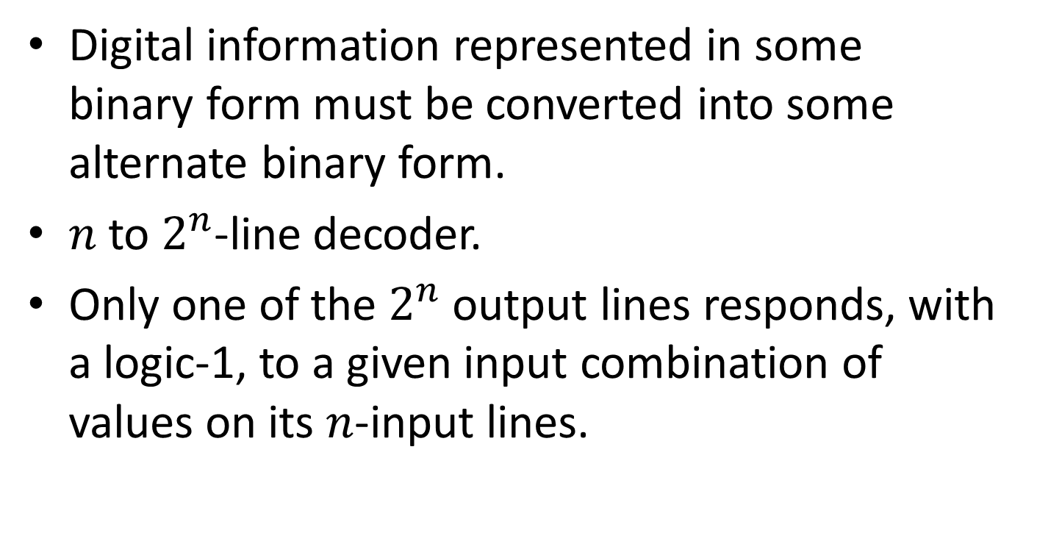
Decoder
Digital information represented in some binary form must be converted into some alternate binary form.
$n$ to $2^{n}$-line decoder.
Only one of the $2^{n}$ output lines responds, with a logic-1, to a given input combination of values on its $n$-input lines.

Slide 10
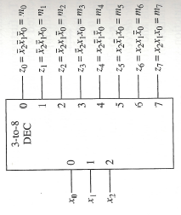
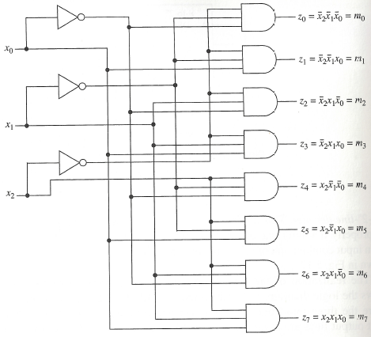
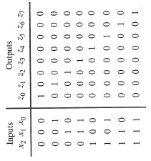
Realization
Symbol
Logic Diagram
Truth Table

Slide 11
Decoder
Input combinations can be regarded as binary numbers with the consequences that the j-th output line is at logic-1 for j = 0, 1, . . , 7 only when input combination j is applied.

Slide 12
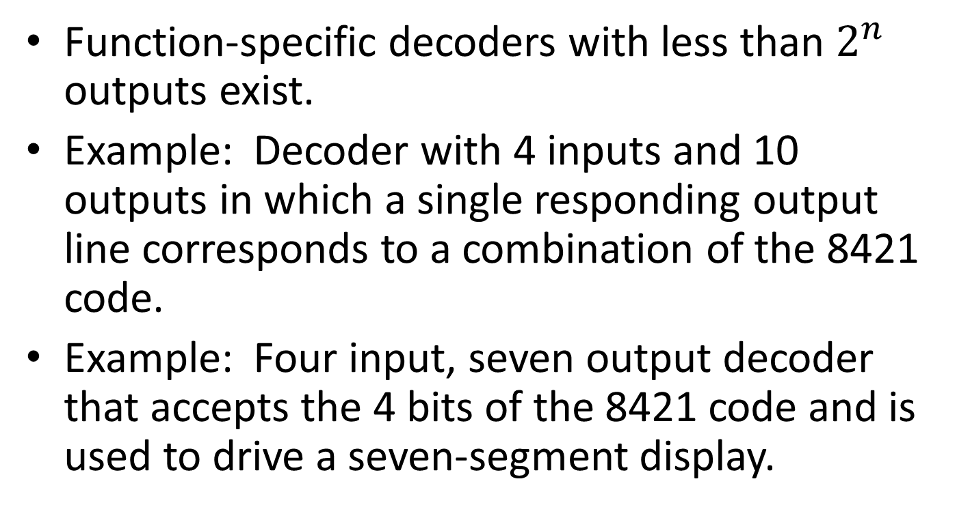
Other types of Decoders
Function-specific decoders with less than $2^{n}$ outputs exist.
Example: Decoder with 4 inputs and 10 outputs in which a single responding output line corresponds to a combination of the 8421 code.
Example: Four input, seven output decoder that accepts the 4 bits of the 8421 code and is used to drive a seven-segment display.

Slide 13
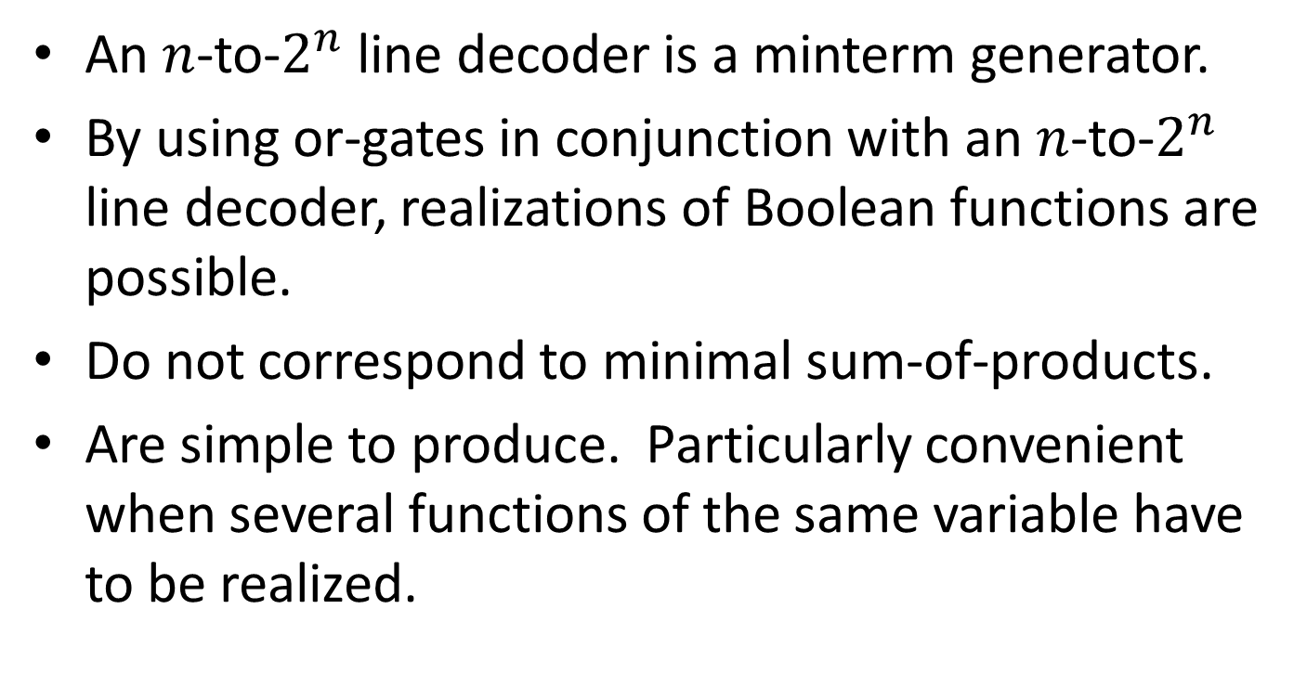
Logic Design Using Decoders
An $n$-to-$2^{n}$ line decoder is a minterm generator.
By using or-gates in conjunction with an $n$-to-$2^{n}$ line decoder, realizations of Boolean functions are possible.
Do not correspond to minimal sum-of-products.
Are simple to produce. Particularly convenient when several functions of the same variable have to be realized.

Slide 14
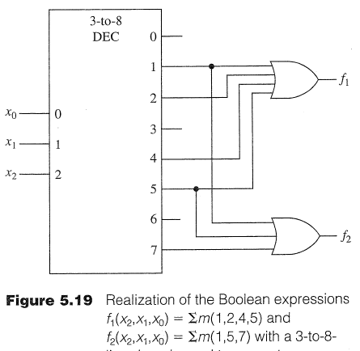
Minterms using OR Gates

Slide 15
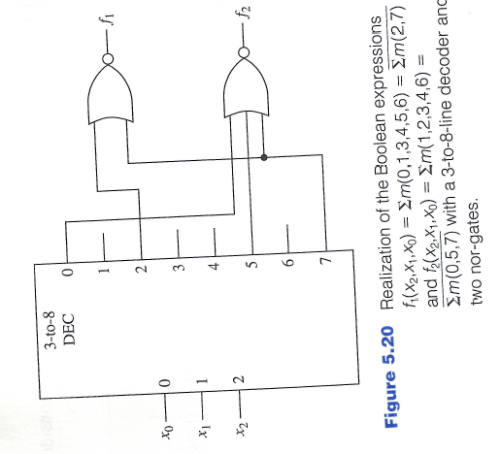
Minterms using NOR Gates

Slide 16
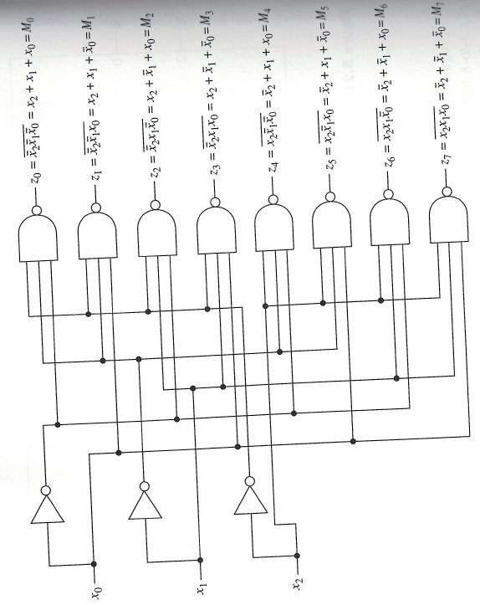
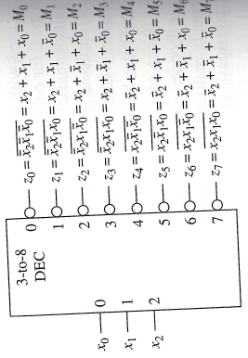
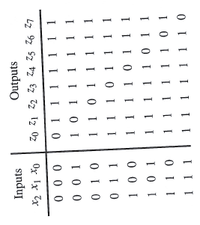
Implementing a Decoder using NAND
Symbol
Logic Diagram
Truth Table

Slide 17
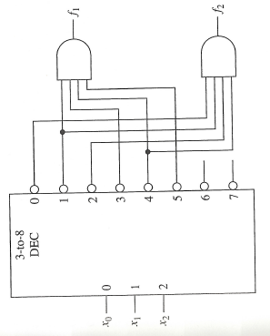
Minterms using AND gates
$$f_{1}=∑m\left(0,2,6,7\right), f_{2}=∑m(3,5,6,7)$$

Slide 18
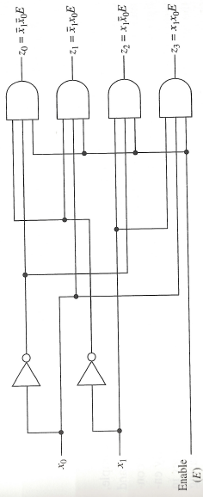
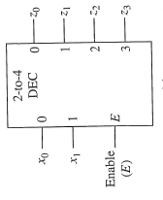
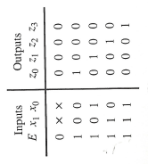
Decoders with an Enable Input
Symbol
Logic Diagram
Truth Table

Slide 19


Decoders with enable inputs
When disabled, all outputs of the decoder can either be at logic-0 or logic-1.
Enable input provides the decoder with additional flexibility. Idea: data is applied to the enable input.
Process is known as demultiplexing.
Enable inputs are useful when constructing larger decoders from smaller decoders.
$${\overline{x}}_{0}{\overline{x}}_{1}E$$
If $x_{0}=0, x_{1}=0$ then data appears on line $z_{0}$.
Data

Slide 20
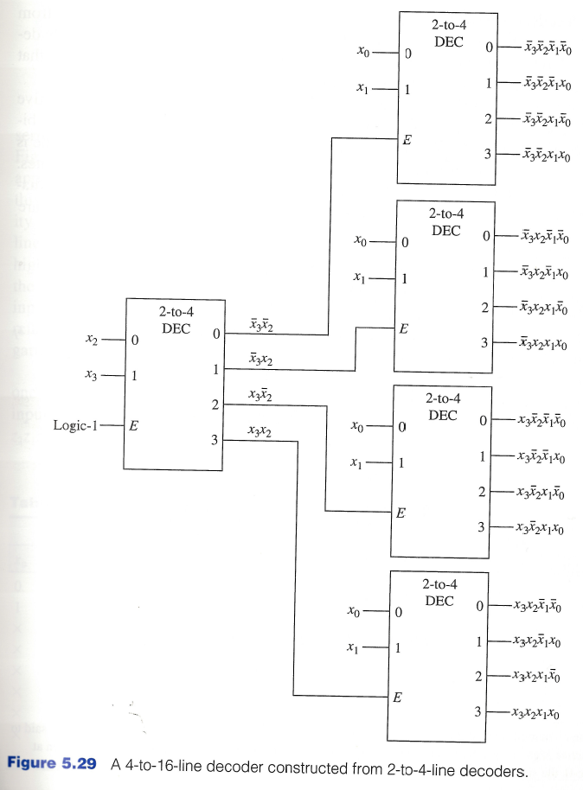
Constructing Larger Decoders

Slide 21
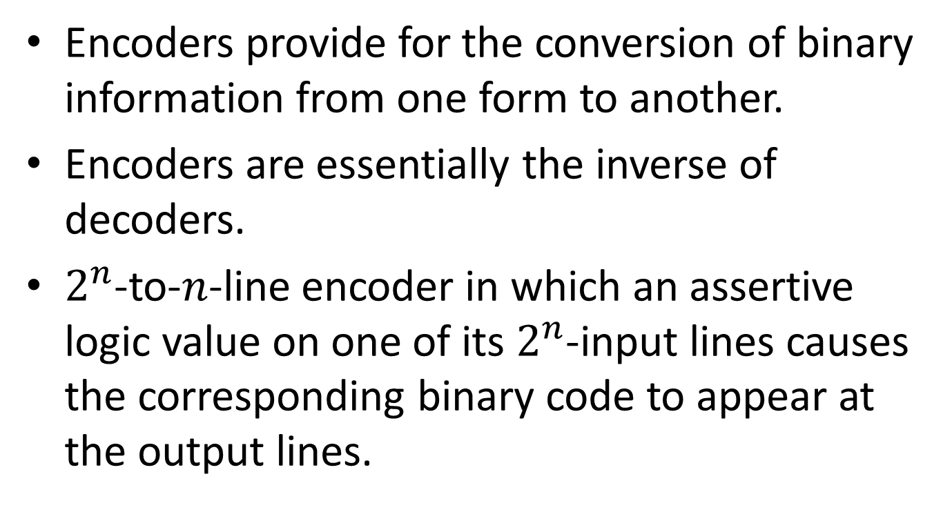
Encoders
Encoders provide for the conversion of binary information from one form to another.
Encoders are essentially the inverse of decoders.
$2^{n}$-to-$n$-line encoder in which an assertive logic value on one of its $2^{n}$-input lines causes the corresponding binary code to appear at the output lines.

Slide 22
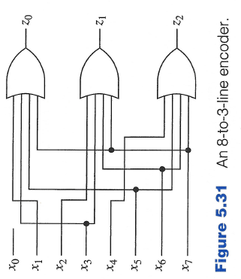
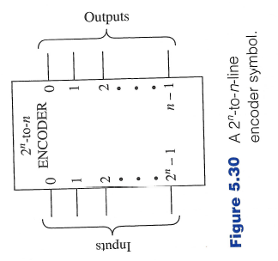

Encoders
Equations for 8-to-3-line encoder:
$$z_{0}=x_{1}+x_{3}+x_{5}+x_{7}$$
$$z_{1}=x_{2}+x_{3}+x_{6}+x_{7}$$
$$z_{2}=x_{4}+x_{5}+x_{6}+x_{7}$$
In general, the Boolean expression for the output $z_{i}$ is the sum of each input $x_{j}$ in which the binary representation of $j$ has a 1 in the $2^{i}$-bit position.

Slide 23
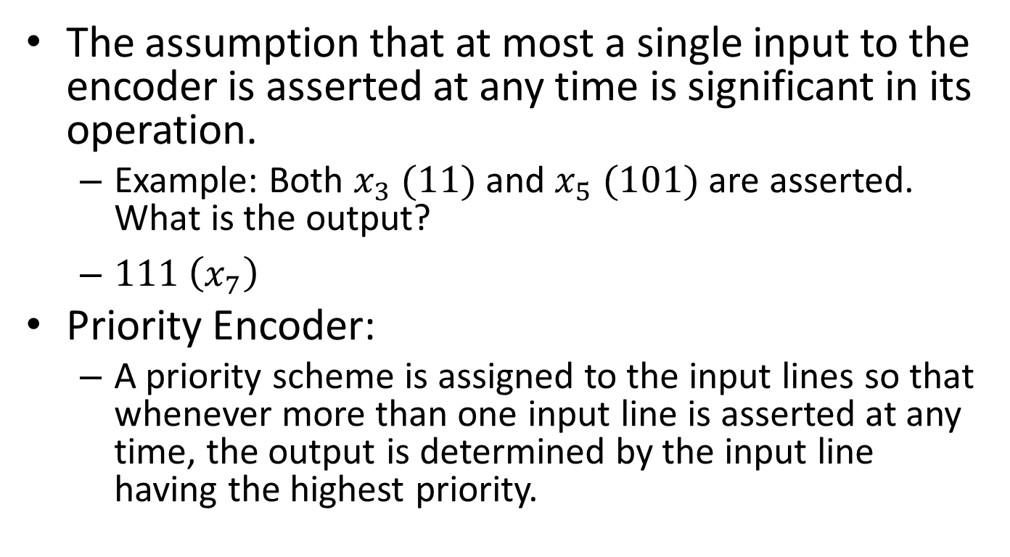
Priority Encoder
The assumption that at most a single input to the encoder is asserted at any time is significant in its operation.
Example: Both $x_{3} (11)$ and $x_{5} (101)$ are asserted. What is the output?
$111 \left(x_{7}\right)$
Priority Encoder:
A priority scheme is assigned to the input lines so that whenever more than one input line is asserted at any time, the output is determined by the input line having the highest priority.

Slide 24
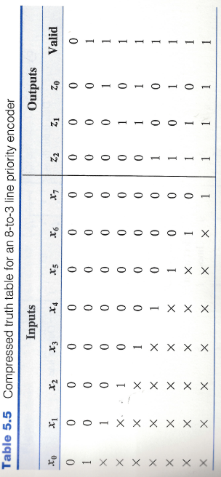
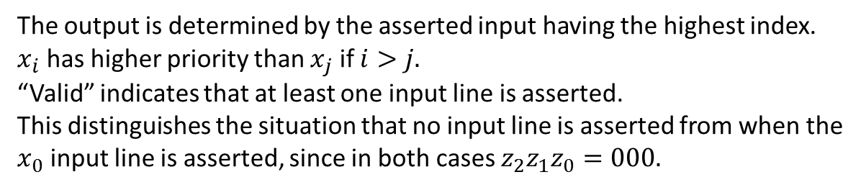
Priority Encoder
The output is determined by the asserted input having the highest index.
$x_{i}$ has higher priority than $x_{j}$ if $i>j.$
“Valid” indicates that at least one input line is asserted.
This distinguishes the situation that no input line is asserted from when the $x_{0}$ input line is asserted, since in both cases $z_{2}z_{1}z_{0}=000.$

